Slide 1
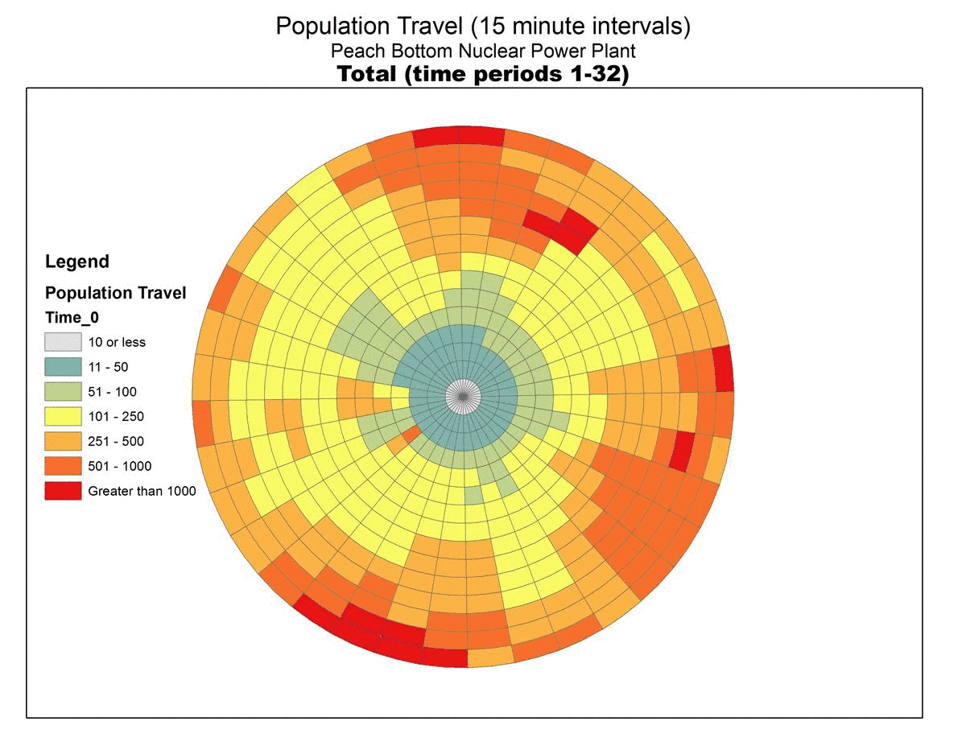
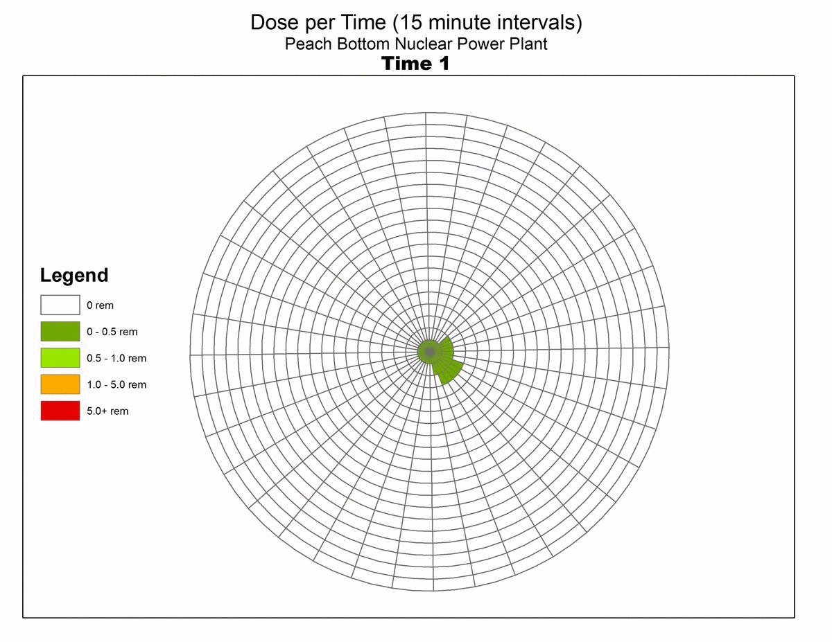
Results from evacuation simulation, which showed that the population in a densely populated area can be safely evacuated if there is accidental release from an SMR. This is because of a lower release amount and slower particle travel
Population Model
Exposure Model

